Slide 1
NPC problems
NP-complete (NPC) problems
Reductions

Slide 2
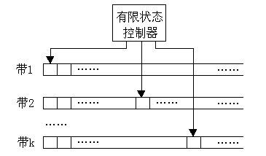
Computation Model: Turing machine
A k-strip TM is a tuple < Q，T，I，δ，b，q₀，q_{f} >:
  Q is a set of finite states
  T is a set of finite symbols
  I is a set of input symbols and I ⊆T
  b is a blank symbol
  q₀ is an initial state
  q_{f} is a final state
  δ is a transfer function: Q×T^{k} → Q× T×{L，R，S}
Finite State Controller
Computation step in TM:
change state
rewrite symbol
make the head move or stay
Strip 1
Strip 2
Strip k

Slide 3
NP-complete problems
P (polynomial) and NP (nondeterministic polynomial)
  NP: the class of all problems that can be solved in polynomial time on nondeterministic TM (Q×T^{k} → 2^{Q}× T×{L，R，S}).
  P: the class of all problems that can be solved in polynomial time on deterministic TM (Q×T^{k} → Q× T×{L，R，S})
  P ≠ NP?
    Not sure.
    Most researchers think so, but no one can prove it.

Slide 4
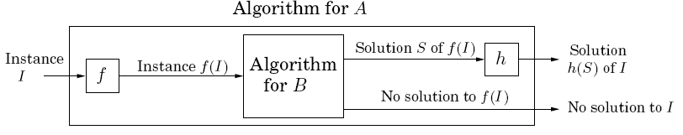
NP-complete problems
Reduction
  A reduction from A to B is f + h
    Both f and h are polynomial-time algorithms
    f transforms any instance I of A into an instance f(I) of B
    h maps any solution S of f(I) back into a solution h(S) of I

Slide 5
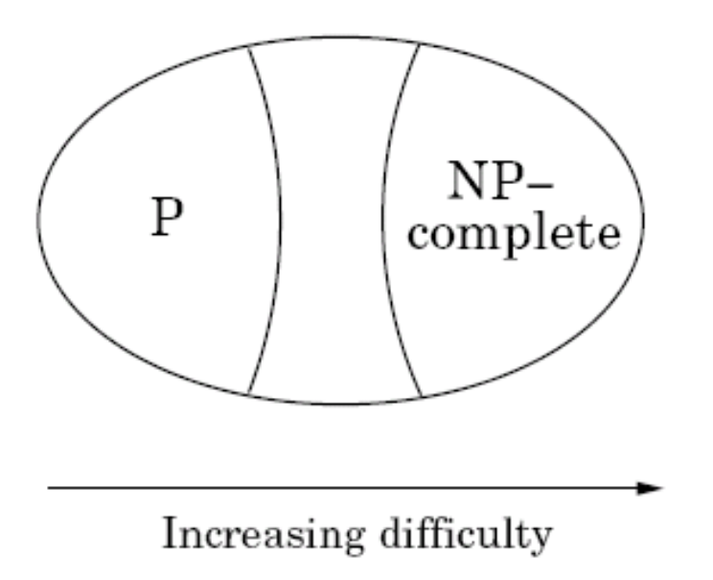
NP-complete problems
NP-complete (NPC)
  The class of the hardest problems (NPC ⊆ NP)
  All other problems reduce to a NPC problem (∀np ∝_{P} npc)
  If one of NPC has a polynomial time algorithm, then every problem in NP can be solved in polynomial time, i.e., P = NP
NP-Intermediate
Between P and NPC
Example: Factoring (n!)
Suppose P ≠ NP

Slide 6
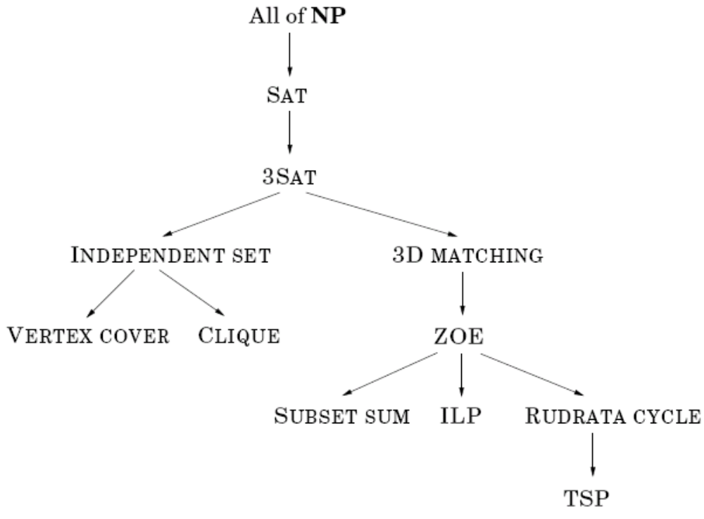
Reduction tree
Cook theorem: SAT is the first NPC problem.

Slide 7

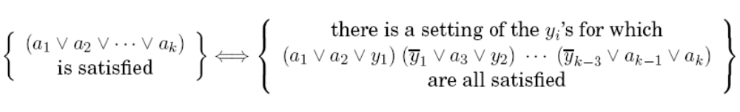
Example 1
SAT → 3SAT
  Reduction: any clause
Left satisfied
Some a_{i} must be true
Set y₁,…, y_{i-2} to true and the rest to false (…(¬y_{i-2}∨a_{i}∨ y_{i-1})(¬y_{i-1}∨a_{i+1}∨ y_{i})…)
Right satisfied
Right satisfied
→ left satisfied (One of a₁,…, a_{k} must be true)
Otherwise (All of a₁,…, a_{k} are false)
  y₁ must be true, y₂ must be true, …, y_{k-3} must be true (¬y_{k-4}∨a_{k-2}∨ y_{k-3})
  False the last clause (Right unsatisfied )

Slide 8
Example 2
3SAT → INDEPENDENT SET
  3SAT: a set of clauses, each with three or fewer literals, find a satisfying truth assignment
  INDEPENDENT SET: find a set of g pairwise non-adjacent vertices
  Reduction maps an instance I of 3SAT into an instance (G, g) of INDEPENDENT SET:
    Graph G has a triangle for each clause (or just an edge, if the clause has two literals), with vertices labeled by the clause’s literals, and has additional edges between any two vertices that represent opposite literals
    The goal g is set to the number of clauses
Notes:
g is #clause
construct G from 3SAT formula

Slide 9
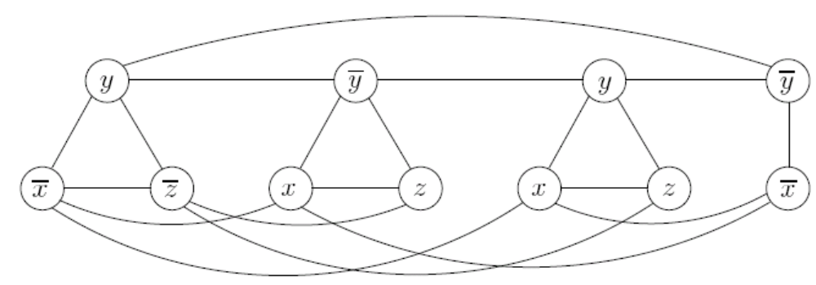
Example 2
3SAT → INDEPENDENT SET

Slide 10

Example 2
3SAT → INDEPENDENT SET
  Given an independent set S of g vertices in G, it is possible to efficiently recover a satisfying truth assignment to I
    assign x a value of true if S contains a vertex labeled x;
    assign x a value of false if S contains a vertex labeled ;
    assign true or false to x if S contains neither x or ;
  If graph G has no independent set of size g, then the Boolean formula I is unsatisfiable
    Prove the contrapositive: I is satisfiable→ independent set of size g
      For each clause, pick any literal whose value under the satisfying assignment is true, and add it to S

Slide 11
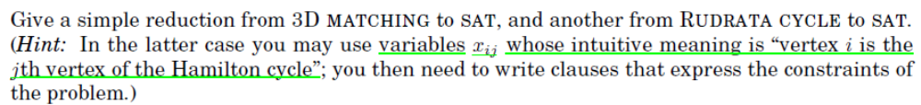
Example 3

Slide 12
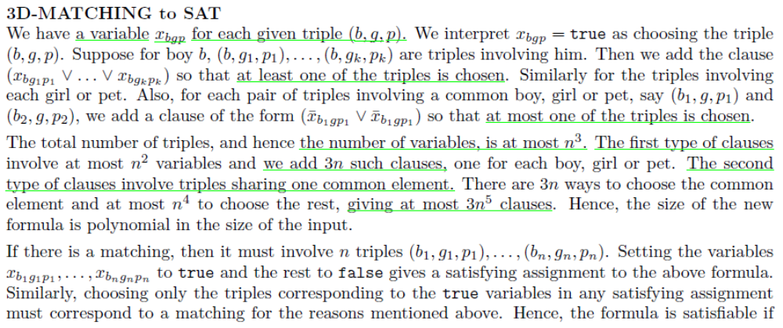
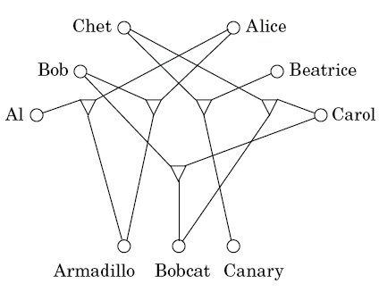
Example 3

Slide 13
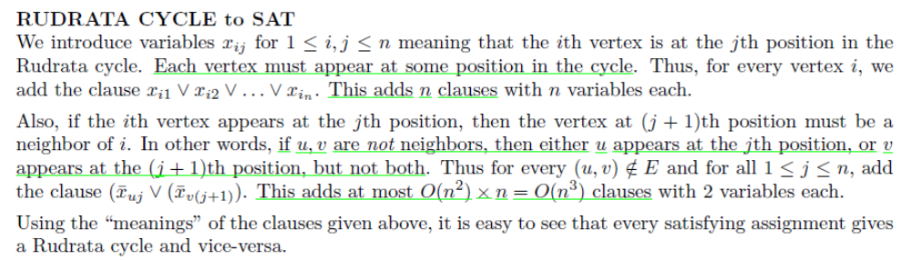
Example 3

